Slide 1
Capstone Presentation
Customer Churn
Presented By: Love Gaur

Slide 2
Business Problem Understanding
An E Commerce company is facing a lot of competition in the current market, and it has become a challenge to retain the existing customers in the current situation. Hence, the company wants to develop a model through which they can do churn prediction of the accounts and provide segmented offers to the potential churners. In this company, account churn is a major thing because 1 account can have multiple customers. hence by losing one account the company might be losing more than one customer.
Therefore, We have been assigned to develop a churn prediction model for this company and provide business recommendations on the campaign so that they can retain their customers and make their business more profitable.
Scope: All the existing customers
Objective: It is more difficult and costly to acquire new customers than retain the existing customers. So, we need to retain the existing customers within a company Hence, we need to build model which can analysis their past data and predict whether customers will churn or not. Once we identify correctly churner customers, we
can intervene before they leave. The study is about reducing the overall churn rate and increasing profitability.

Slide 3
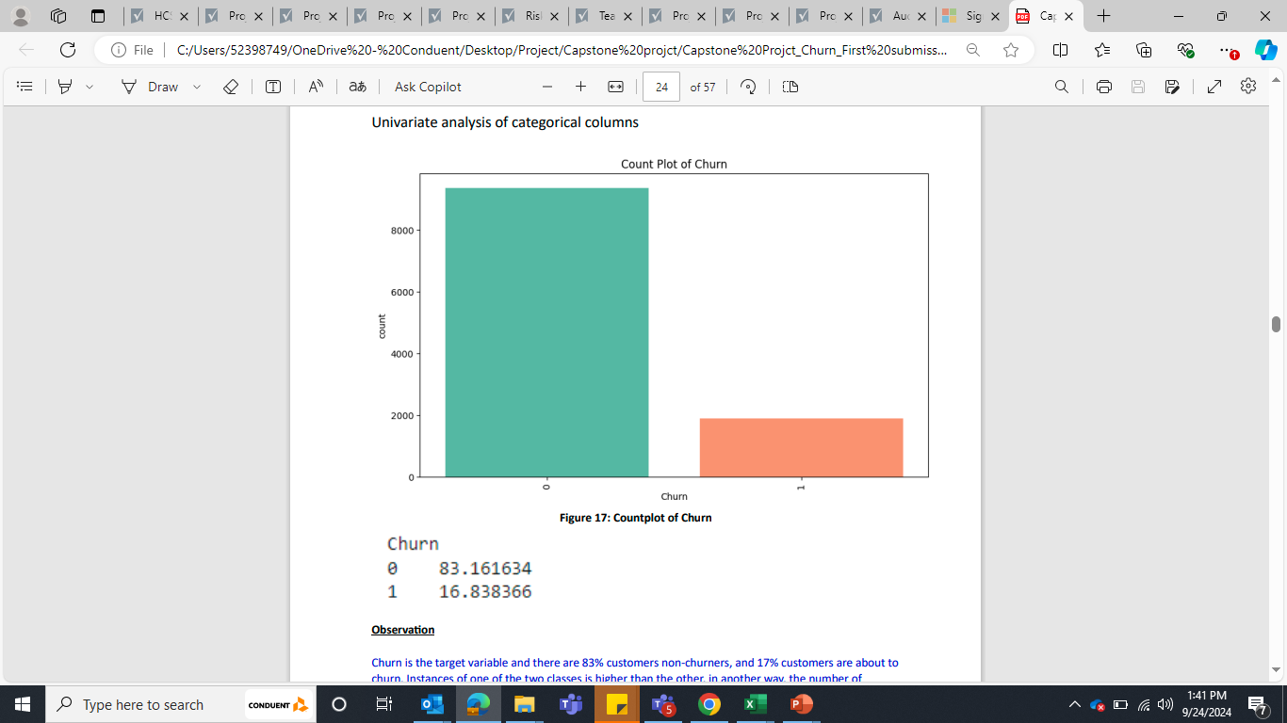
Data overview and EDA
There are 11260 observations and 19 variables in the dataset.
There are missing values in many columns.
There are 5 variables float type, 12 are Object datatype and 2 are integer datatypes.
There are irregularities and inconsistency in the data.
There are no duplicate rows in dataset
There are outliers present in many columns.
Targeted variable “Churn” is showing that the data is imbalance.
Churn is the target variable and there are 83% customers non-churners, and 17% customers are about to churn. Instances of one of the two classes is higher than the other, in another way, the number of observations is not the same for all the classes in a classification dataset. This means that data is unbalanced.

Slide 4
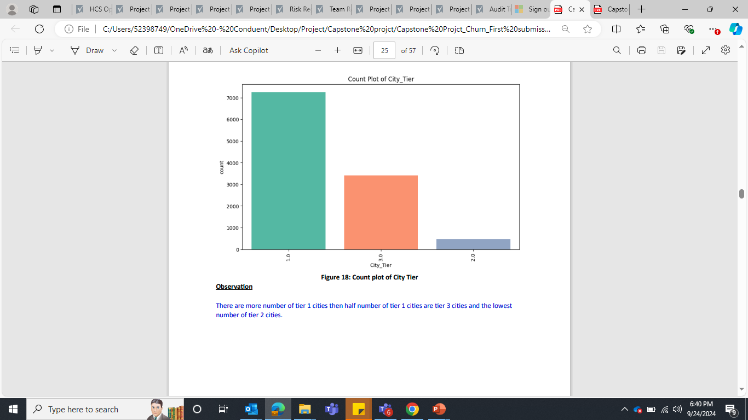
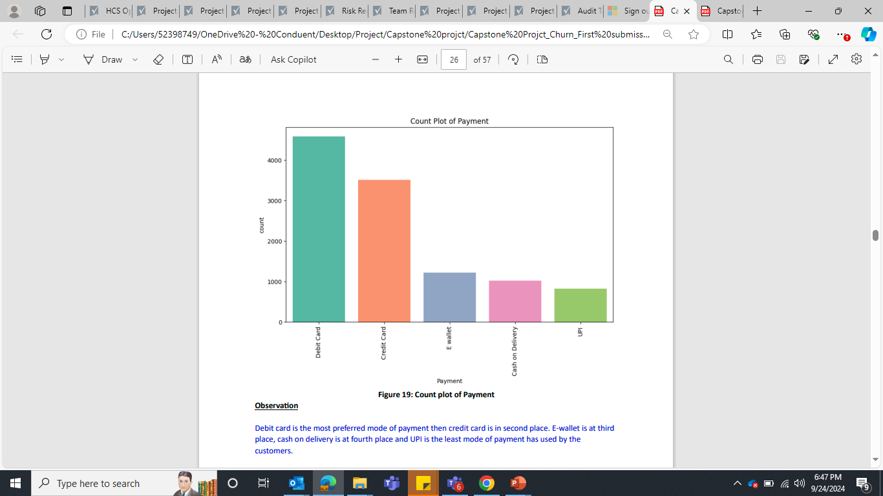
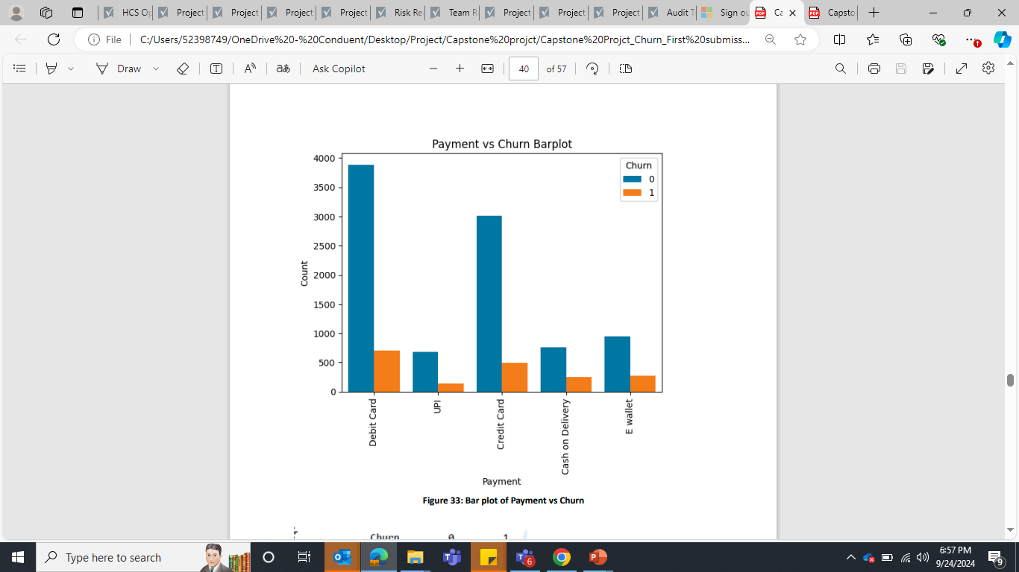
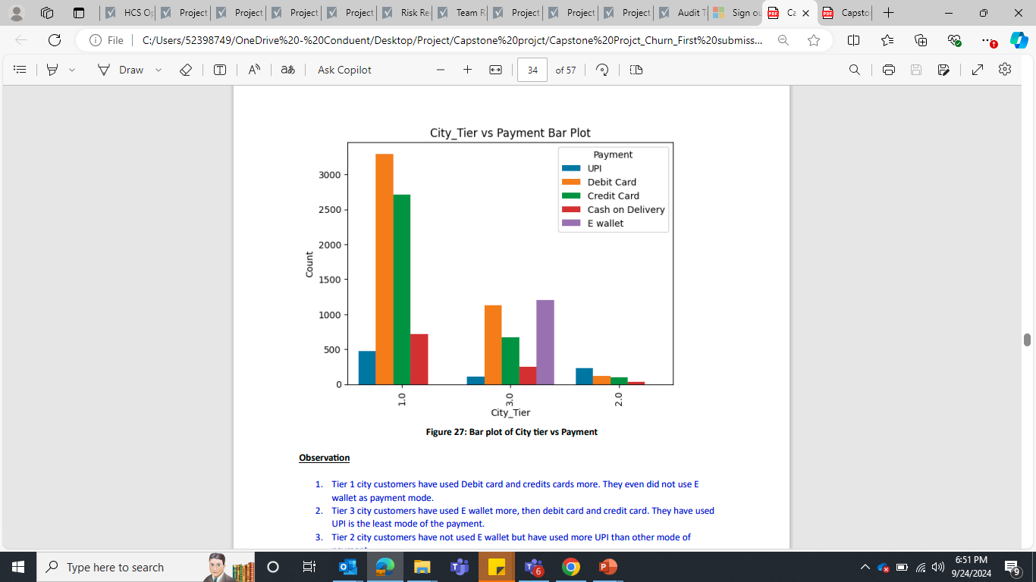
Insights from EDA Analysis
Debit card is the most preferred mode of payment then credit card is in second place and UPI is the least mode of payment has used by the customers.
The majority population is from Tier 1
Customers of Tier 1 cities are likely more using traditional payment methods like debit and credit cards and No E-Wallet Usage.
Tier 3 city customers are more inclined towards using E-wallets, likely due to the convenience and ease of use and Low UPI Usage.
Tier 2 city customers have not used E wallet but have used more UPI than other mode of payment.
COD and E-wallet have a higher churn rate compared to other payment methods. This could be because COD might be associated with a higher risk of order cancellations or returns, leading to dissatisfaction or inconvenience for both customers and businesses. For EWallet, this could be due to issues such as limited acceptance, perceived lack of security, or dissatisfaction with e-wallet services

Slide 5
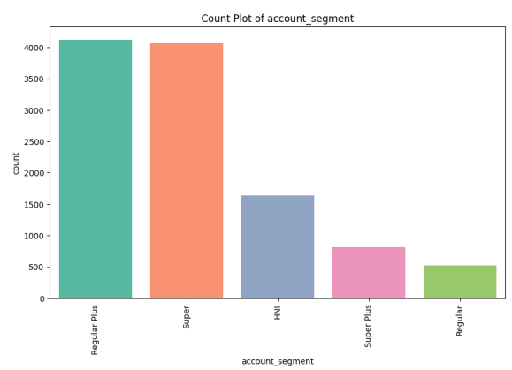
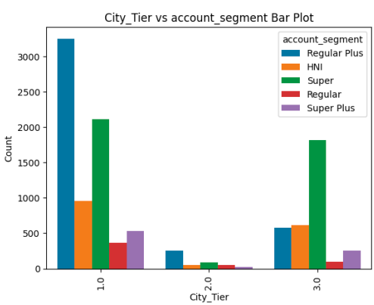
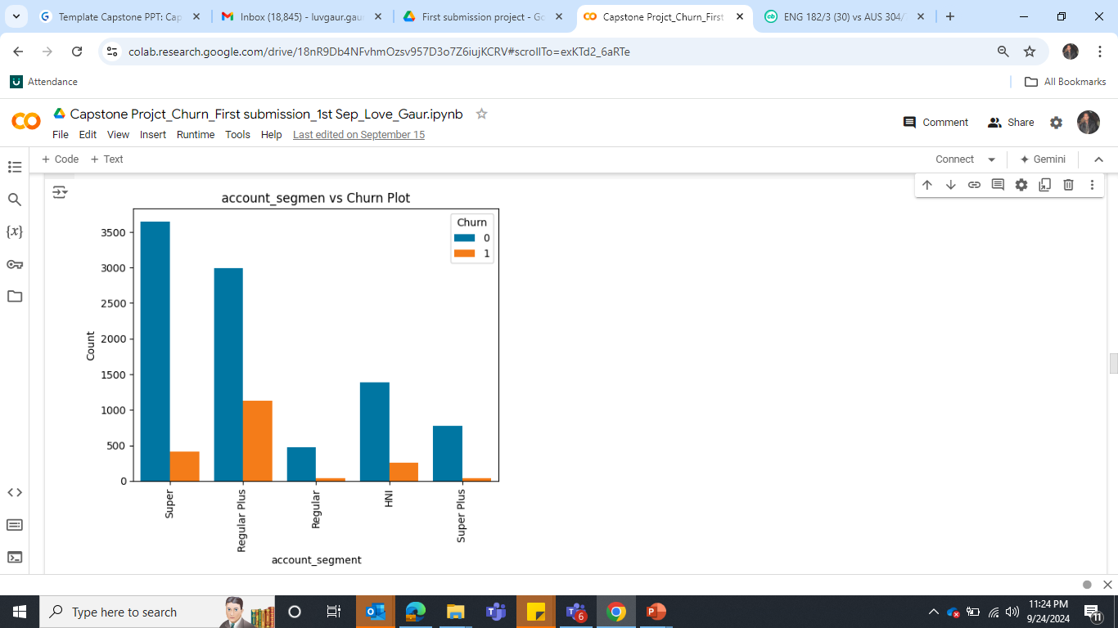
Insights from EDA Analysis
Regular plus account has more number of spend and Super has the second highest in the list and Regular is standing at last place.
Regular Plus Customers have the highest likelihood of churning. This could be due to several factors such as Value Perception, Service Expectations & Competition.
HNI customers are also more likely to churn, This could be due to Personalized Service & Exclusive Offers.
Super Plus & Regular Customers - These customers have a lower churn rate compared to Regular Plus and HNI.
Super customers have a moderate churn rate. They are more stable than Regular Plus and HNI but not as secure as Regular customers. This might be due to Service Quality and Competitive Pressure.

Slide 6
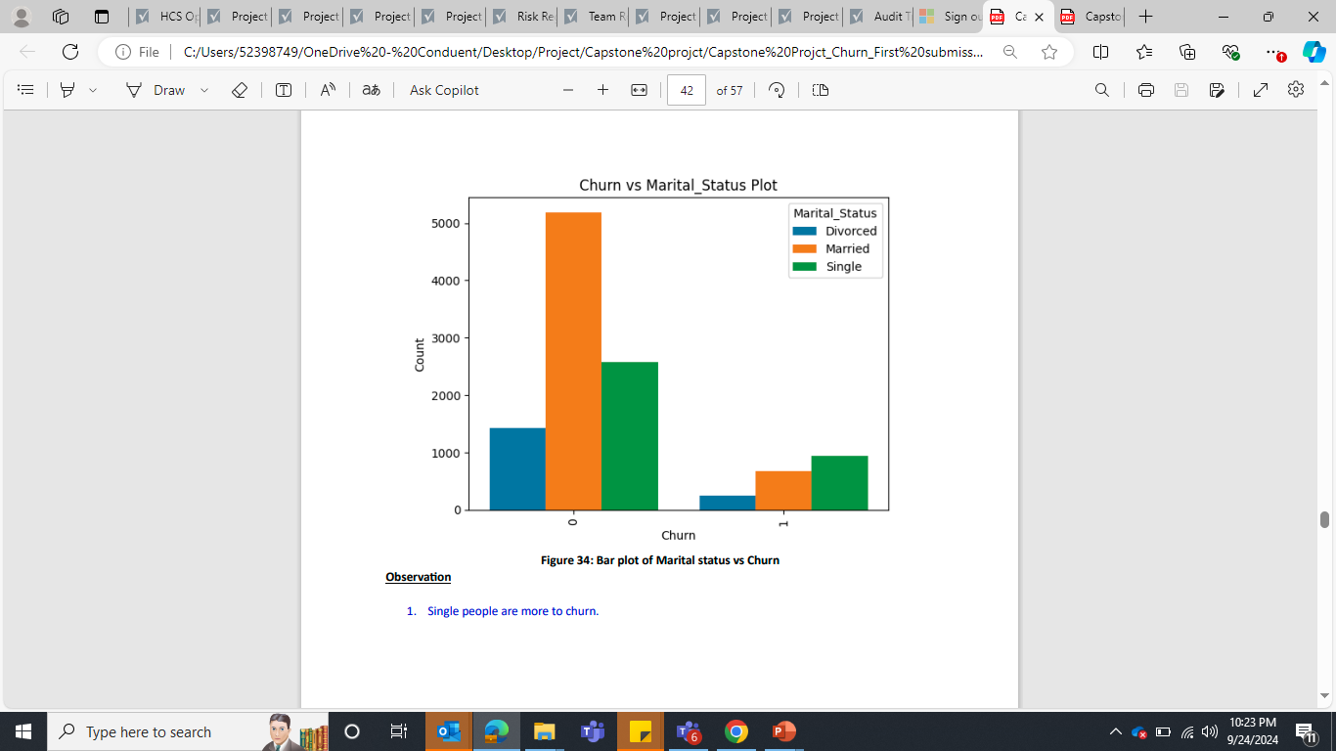
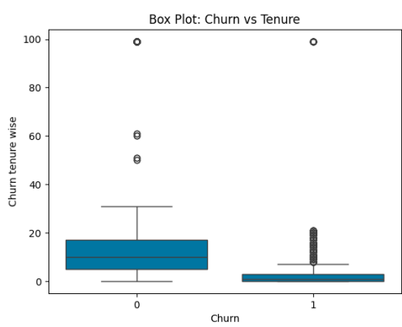
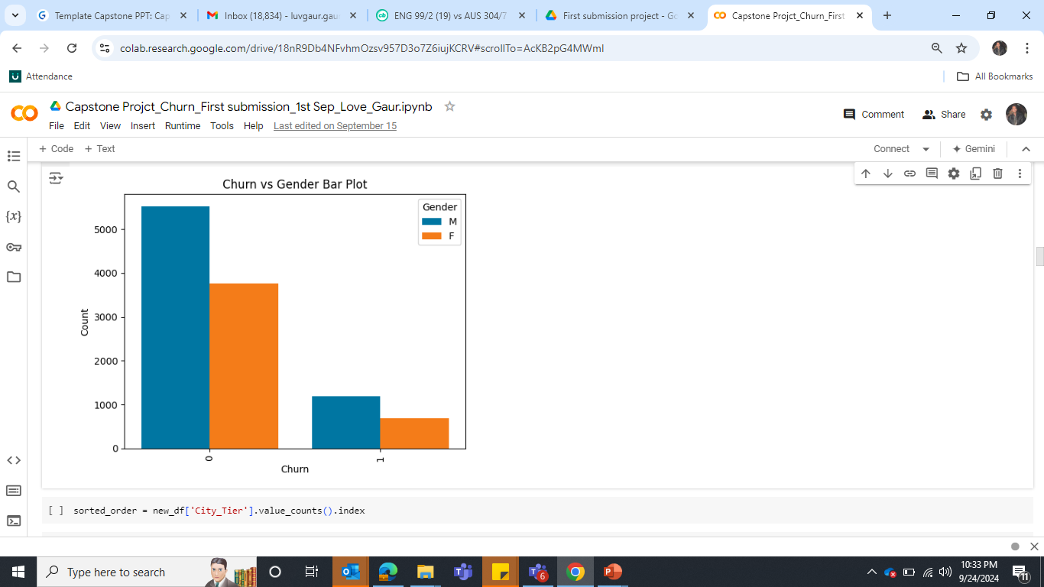
Insights from EDA Analysis
Single people are more to churn, are more than 50% of the churn group, indicating they are the most at risk for leaving. This could be due to their lifestyle flexibility or willingness to explore other services or products.
Customers who have small tenure are more likely to churn
Males are slightly more likely to churn compared to females. Males might be more inclined to explore competitive alternatives or might be less satisfied with their current service, leading to higher churn.

Slide 7
Modelling Approach Used and Why
Steps before build the model
Split the dataset into Train and Test.
Since the data was imbalanced so To deal with unbalanced data, we are planning to apply SMOTE (Synthetic Minority Over-sampling Technique).
Scale the data.
Modelling Approach
Since this is a binary classification problem (Churn or Non – Churn), we build the following models and will take the best model in among all.
Logistic Regression Model
Naive Bayes
KNN Model
Random Forest Model
Boosting
Bagging

Slide 8
Modelling Approach Used and Why
Model Steps
Build the model on train dataset and validate it on test dataset.
Create ROC and AUC map for both the train and test dataset.
Create confusion matrix and classification report.
We will check and compare the Accuracy, recall, Precision and F1-score values. The deviation should be 10% between Train and Test dataset.
HyperTune the models to improve the accuracy.
Change the threshold value.
Use Ensemble technique
Finalize the final best model
Variable Importance, its impact on Dependent variable.

Slide 9
Compare Model Outputs
Models | Accuracy Train | Accuracy Test | Recall Train | Recall Test | Precision Train | Precision Test | F1 Score Train | F1 Score Test | AUC train | AUC test
Logistic Regression Model | 0.88 | 0.87 | 0.81 | 0.58 | 0.89 | 0.63 | 0.85 | 0.6 | 0.937 | 0.937
Regularized Logistic Regression Model | 0.88 | 0.85 | 0.84 | 0.63 | 0.87 | 0.56 | 0.85 | 0.59 | 0.937 | 0.848
Logistic Regression Model HyperTune | 0.88 | 0.85 | 0.84 | 0.63 | 0.86 | 0.56 | 0.85 | 0.59 | 0.937 | 0.847
Logistic Regression Change threshold | 0.85 | 0.85 | 0.89 | 0.63 | 0.79 | 0.56 | 0.84 | 0.59 | 0.937 | 0.847
Gaussian Naïve Bayes | 0.76 | 0.72 | 0.75 | 0.58 | 0.7 | 0.32 | 0.76 | 0.41 | 0.84 | 0.72
Gaussian Naïve Bayes HyperTune | 0.76 | 0.72 | 0.75 | 0.58 | 0.7 | 0.32 | 0.73 | 0.41 | 0.84 | 0.72
KNN model | 0.98 | 0.94 | 0.98 | 0.85 | 0.98 | 0.82 | 0.98 | 0.84 | 0.99 | 0.97
KNN model HyperTune | 0.98 | 0.95 | 0.97 | 0.81 | 0.98 | 0.88 | 0.98 | 0.95 | 0.99 | 0.97
Random Forest model | 1 | 0.97 | 1 | 0.86 | 1 | 0.95 | 1 | 0.9 | 1 | 0.98
Random Forest model HyperTune | 0.99 | 0.95 | 0.99 | 0.83 | 0.98 | 0.84 | 0.99 | 0.84 | 0.99 | 0.97
Ada Boosting | 0.89 | 0.89 | 0.86 | 0.69 | 0.89 | 0.65 | 0.87 | 0.67 | 0.95 | 0.89
Ada Boosting HyperTune | 0.8 | 0.72 | 0.97 | 0.91 | 0.69 | 0.37 | 0.8 | 0.72 | 0.95 | 0.9
Ada Boosting changed threshold value | 0.99 | 0.95 | 0.99 | 0.82 | 0.99 | 0.87 | 0.99 | 0.84 | 0.98 | 0.89
Gradient Boosting | 0.91 | 0.9 | 0.87 | 0.71 | 0.92 | 0.71 | 0.89 | 0.71 | 0.97 | 0.92
Gradient Boosting HyperTune | 1 | 0.96 | 1 | 0.86 | 1 | 0.9 | 1 | 0.88 | 1 | 0.99
Gradient Boosting HyperTune adjusted Parameters | 1 | 0.98 | 1 | 0.9 | 1 | 0.96 | 1 | 0.93 | 1 | 0.99
Bagging Model | 1 | 0.96 | 1 | 0.85 | 1 | 0.92 | 1 | 0.89 | 1 | 0.97
Bagging Model HyperTune | 1 | 0.97 | 1 | 0.87 | 1 | 0.98 | 1 | 0.92 | 1 | 0.96

Slide 10
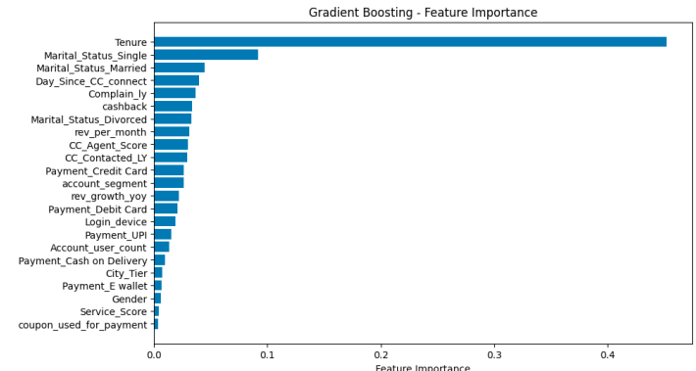
Best Model Selection
From the above table, It is observed that Gradient Boost HyperTune adjusted parameters is better among all the models.
Gradient Boost after hyper tune adjusted parameters outperforms other models in terms of accuracy, recall of positive cases, and AUC score on both training and test sets.
Bagging (Hypertuning) also performs very well with slightly lower recall, but higher precision compared to Gradient Boost. Since our focus is on recall more, Gradient Boost after hyper tune adjusted parameters is our first choice.
The most important features in the final model.
Tenure is the most important feature, followed by Marital status as per the tuned gradient boosting model.

Slide 11
Recommendations
Tier 1 City Customers -
To encourage continued loyalty, offer incentives such as cashback or discounts for customers using debit or credit cards.
Launch awareness campaigns highlighting the benefits of using e-wallets (e.g., faster transactions, exclusive offers). Collaborate with e-wallet providers to offer promotions to Tier 1 customers, emphasizing convenience and security.
Tier 3 City Customers
Continue offering and improving e-wallet-based offers and promotions, as these customers are more inclined to use them.
Educate on UPI Benefits: Conduct awareness campaigns or workshops about the ease and security of UPI payments to increase its adoption in Tier 3 cities. Offering simple guides or incentives for first-time UPI users may also encourage adoption.
Tier 2 City Customers:
Focus on promoting UPI-related discounts, cashback, or other rewards, as these customers have embraced the convenience of UPI.

Slide 12
Recommendations
COD and E-Wallet Usage
Introduce incentives for prepaid transactions or offer faster delivery and easier returns for prepaid orders to shift away from COD and reduce risks of order cancellations.
Partner with more merchants to increase the acceptance of e-wallets and resolve potential user issues, such as security concerns or limited usability.
Regular Plus Customers Segment
Increase Value Perception: Offer personalized rewards, exclusive offers, or better loyalty points to Regular Plus customers. Highlight the additional benefits of staying loyal, such as priority customer service or access to premium features.
Monitor Satisfaction: Implement frequent satisfaction surveys or engagement tracking to proactively address any dissatisfaction before it leads to churn.
High Net-Worth Individuals (HNIs)
Invest in customer relationship management to offer tailored services for HNIs. This could include dedicated relationship managers, exclusive events, or personalized financial or service advice.
Create Exclusive Offers.

Slide 13
Recommendations
Super Plus & Regular Customers
Ensure that customer service and product offerings remain consistent to retain these customers.
Super Customers
Reassess pricing, customer service, and product offerings for this segment to prevent competitors from drawing them away. Offering regular updates on new features or improvements can keep them engaged.
Single People
More likely to churn, offer flexible pricing plans or services that cater to the lifestyle of single individuals. Ensure engagement through personalized offers, tailored communications, and targeted messaging around convenience or excitement.
Short Tenure Customers
Create a seamless and engaging onboarding process for new customers. Provide extra attention in the first 3-6 months with special welcome offers, product tutorials, and proactive support to help them fully realize the value of your service.

Slide 14
Recommendations
Males are slightly more likely to churn than females. Personalize communication and offers to target male customers based on their preferences. Competitive pricing and innovative product features may help retain their interest.

